Slide 1
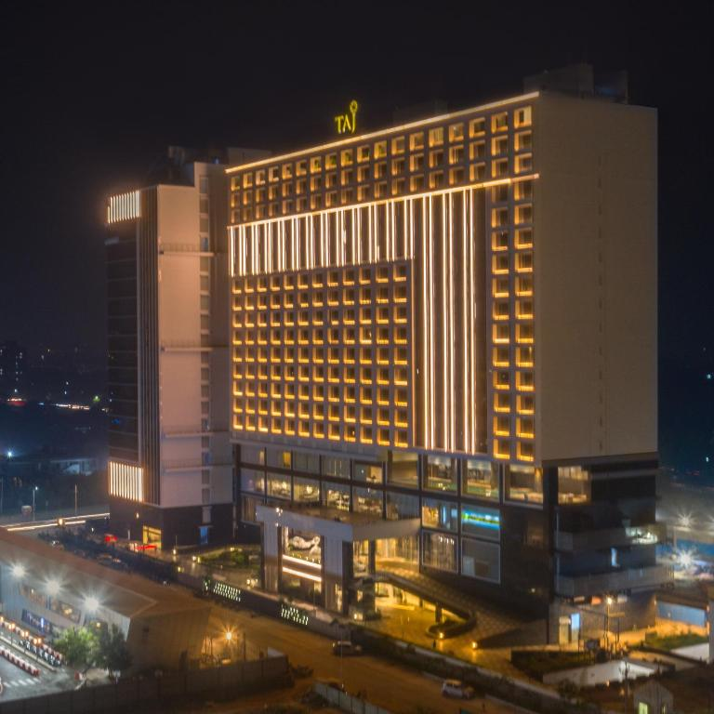
ADA On Hotel Booking
Presented by Ashit Chaudhary
Guided by :- Abhishek wavhal Professor

Slide 2
Summary of my project
This Project was given to us by the Abhishek sir with an intention to understand the Business done by Hotel Group.
This Dataset had two hotels City Hotel and Resort Hotel.
The data provided was for 3 years 2015 , 2016 and 2017.we also have the revenue and booking details with number of days of stay and booking cancellation, total number of guests including children. It also specifies guests wait period for booking , repetition of guests, their food choices among others. The data also gives us an analyzation of countries from which bookings have been done. We also a agent and other channels who also help in business by booking rooms for guests on the resort and city hotel behalf.
The data is divided between city hotel and resort hotel. Hence we can make a fair comparison between both.
Before visualize any data from the data set We will do the data cleaning as to fill any null values and delete any duplicated values and after that we have to do data wrangling.
Also we will do our analysis for both city and resort as individual businesses and in comparison to one another. We will also take help of charts for better analysis.

Slide 3
Problem Statement
This data set contains booking information for a city hotel and a resort hotel, and includes information such as when the booking was made, the number of adults, children, and/or babies, and the number of available parking spaces, which agent made the booking, among other things.
The objective of this project is Explore and analyze the data to discover important factors that govern the bookings.

Slide 4
Define Business Objective ?
Analyse and visualize the data on bookings of City Hotel and Resort Hotel to gain insights on the different factors that affect the booking and ADR.
ADR: Average Daily Rate

Slide 5
Information About The Data (Column Discription
Hotel - Type of hotel(Resort or City).
is_canceld - If there was booking cancel(0) or not(1).lead time - The number of days between time books their room to arrive hotel.
arrival_date_year - Year of arrival date.
arrival_date_month - Month of arrival date.
arrival_date_week_number - Week no. of year for arrival date.
stays_in_weekend_nights - No. of weekend nights(Saturday or sunday) spend by guest at hotel.
stays_in_week_nights -No. of weeknight( Mon to Fri) spend by guest at hotel.
adults - No. of adults among guest.
children - No. of children among guest.
babies - No. of babies among guest.meal - Type of meal booked by guest.
country - Country of guest.
market_segment - grouping into categories based on their booking patterns and travel habits.
distribution_channel - Name of booking distribution channel.
is_repeated_guest - If the booking was from repeated by guest(1) or not(0).
previous_cancelletions - No. of previous booking that were cancelled by the customer prior to the customer booking.

Slide 6
previous_cancelletions - No. of previous booking that were cancelled by the customer prior to the customer booking.
previous_booking_not_canceled - No. of previous booking that were not cancelled by the customer prior to the customer booking.
reserved_room_type - Code of room type reserved.
assigned_room_type - code of room type reserved.
booking_changes - No. of changes made to the booking.
deposit_type - Type of the deposit made by the guest.
agent - Id of the agent who made the booking.
company - Id of the company that made the booking.
days_in_waiting_list - No. of days the booking on the waiting list.
customer_type - Type of customer, assuming one of four categories.
adr - (Average Daily Rate) dividing the sum of lodgging transaction by the total number of staying night.
required_car_parking_spaces - No. of car parking spaces required by the customer.
total_of_special_request - No. of special request made by the customer.
reservation_request - Reservation status
reservation_request_date - Date of last reservation status updated.

Slide 7
TABLE OF CONTENTS
1 – Extract 4-Cleaning
2-Transform 5-chart
3-load 6-Result

Slide 8
1.Data Extract:
First I checked that the data is in which form like, Excel,Csv,Sql…
Then i find the data is in Csv file.
Data from csv file taken in Power BI.
2. Transform:
Transform the collected data in to the Power Bi.

Slide 9
3.Cleaning:
After transform the data in Power Bi , i have done first process is change the data types where i need.
Second step which i follow is merged the date column using custom column and convert it to the date format.
Then remove null values and error in the hotel data.
Set A primary key as a guest Id in the Hotel data.
4.Load
After completing all the processes of the cleaning, I loaded the data using close and Apply.

Slide 10
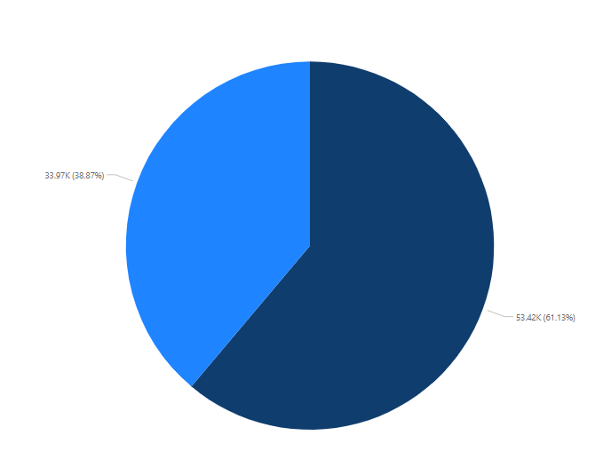
I used the pie chart To check and understand the hotel type is resort or city in simple way of visualizing.
Based on the above observations, I found that 61.07% preferred city hotel and 38.93% preferred to book a resort hotel . Which means Resort hotels have less booking
Are there any insights that lead to negative growth? Justify with specific reason . City hotel can find more services to attract more guests to increase more revenue . Resort Hotel can find a solution to attract customers and also find the facilities provided by the city Hotel to attract customers . So Yes, gained insights help creating a positive business impact.

Slide 11
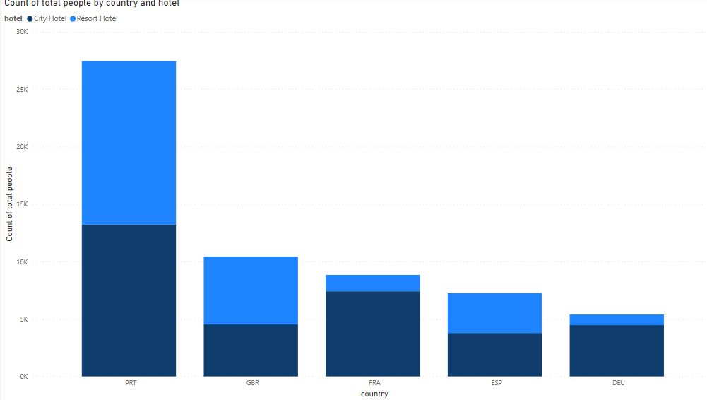
I used the Bar chart To check and understand the hotel type is resort or city in simple way of visualizing.
Based on the above observations, I found that in Portugal Country“14,238” people preferred Resort hotel and “13,211” preferred to book a City hotel . And also fond that most of people prefers Resort hotel Which means City hotels have less booking
Are there any insights that lead to negative growth? Justify with specific reason . City hotel can find more services to attract more guests to increase more revenue . Resort Hotel can find a solution to attract customers and also find the facilities provided by the city Hotel to attract customers . So Yes, gained insights help creating a positive business impact.

Slide 12
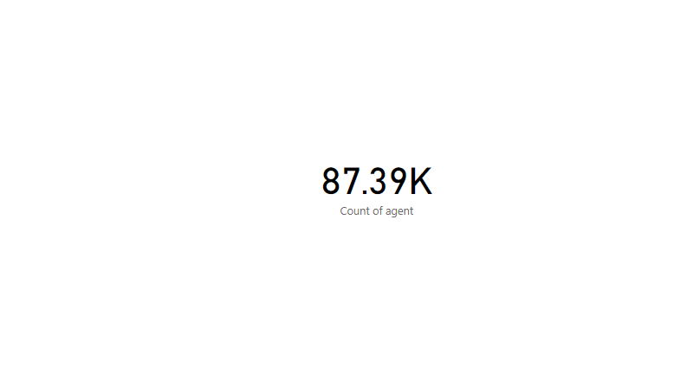
I used the Card (KPI) chart To check and understand the hotel type is resort or city in simple way of visualizing.
Based on the above observations, I found that “87.39k” Bookings Through Agents
Are there any insights that lead to negative growth? Justify with specific reason . City hotel can find more services to attract more guests to increase more revenue . Resort Hotel can find a solution to attract customers and also find the facilities provided by the city Hotel to attract customers . So Yes, gained insights help creating a positive business impact.

Slide 13
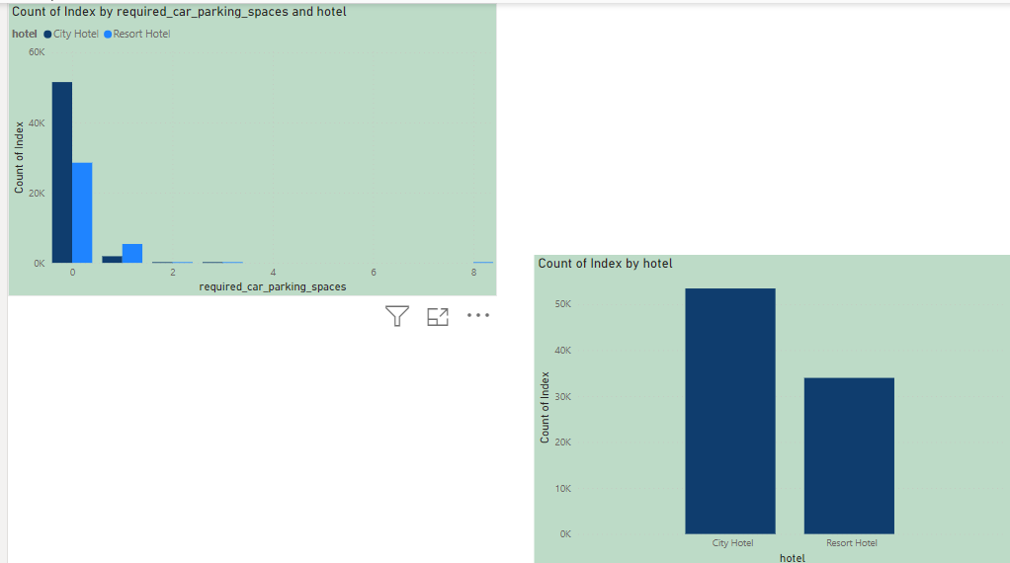
I used the bar chart To check and understand the hotel type is resort or city in simple way of visualizing.
Based on the above observations, I found that “51528 city hotel not have parking and 28551 resort hotel also not have parking facility preferred to book a resort hotel . Which means Resort hotels have less booking
Are there any insights that lead to negative growth? Justify with specific reason . City hotel can find more services to attract more guests to increase more revenue . Resort Hotel can find a solution to attract customers and also find the facilities provided by the city Hotel to attract customers . So Yes, gained insights help creating a positive business impact.

Slide 14
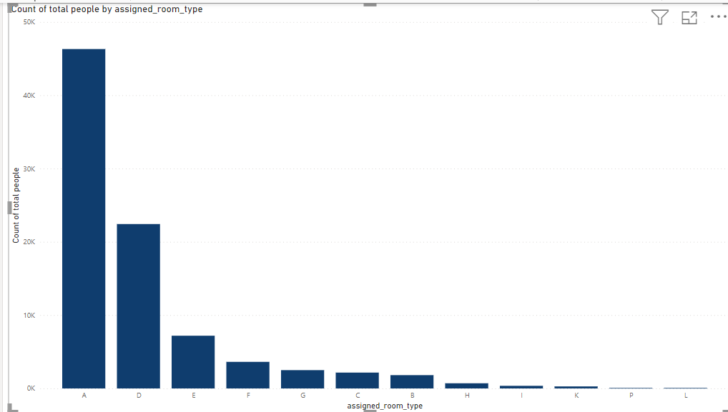
I used the Column chart To check and understand the hotel type is resort or city in simple way of visualizing.
Based on the above observations, I found that 46313 people preferred A room and L room have a lowest booking in both hotels.
Are there any insights that lead to negative growth? Justify with specific reason . City hotel can find more services to attract more guests to increase more revenue . Resort Hotel can find a solution to attract customers and also find the facilities provided by the city Hotel to attract customers . So Yes, gained insights help creating a positive business impact.

Slide 15
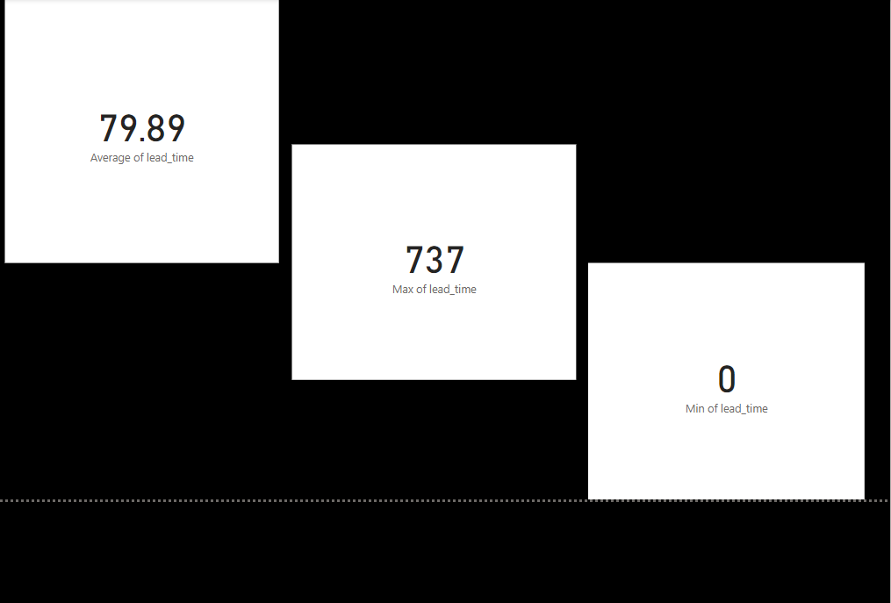
I used the Card To check and understand the hotel type is resort or city in simple way of visualizing.
Based on the above observations, I found that AVRAGE Lead time 79.89 days and min lead time is 0 preferred city hotel. And max ,lead tome is 737 days which is not good for business .
Are there any insights that lead to negative growth? Justify with specific reason . City hotel can find more services to attract more guests to increase more revenue . Resort Hotel can find a solution to attract customers and also find the facilities provided by the city Hotel to attract customers . So Yes, gained insights help creating a positive business impact.

Slide 16
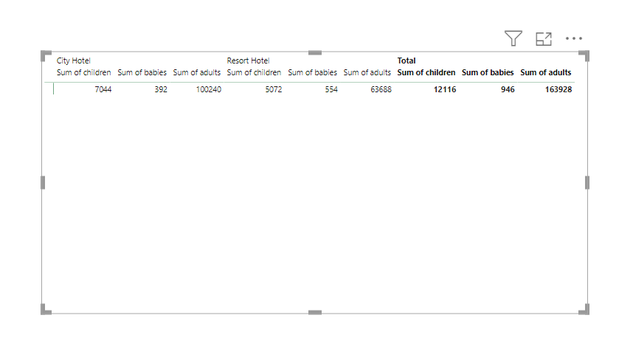
I used the Table To check and understand the hotel type is resort or city in simple way of visualizing.
Based on the above observations, I found that In hotels Mostly Adults And Groups Are Preferred To stay in Resorts . Family is Preferred to Stay in City Hotel.
Are there any insights that lead to negative growth? Justify with specific reason . City hotel can find more services to attract more guests to increase more revenue . Resort Hotel can find a solution to attract customers and also find the facilities provided by the city Hotel to attract customers . So Yes, gained insights help creating a positive business impact.

Slide 17
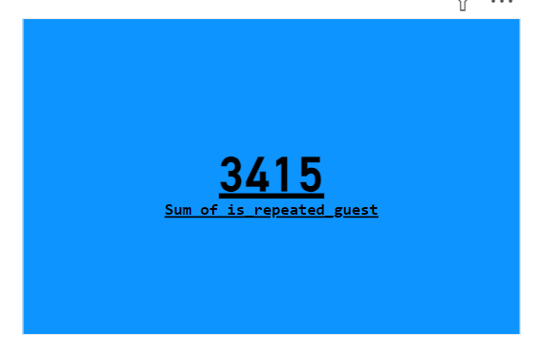
I used the card To check and understand the hotel type is resort or city in simple way of visualizing.
Based on the above observations, I found that Total “3,415” Guests Are Repeated to Stay in the hotel in normal Days.
Are there any insights that lead to negative growth? Justify with specific reason . City hotel can find more services to attract more guests to increase more revenue . Resort Hotel can find a solution to attract customers and also find the facilities provided by the city Hotel to attract customers . So Yes, gained insights help creating a positive business impact.

Slide 18
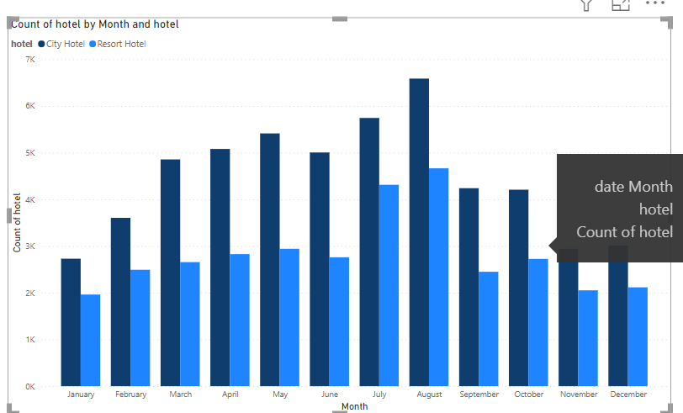
I used the Column To check and understand the hotel type is resort or city in simple way of visualizing.
Based on the above observations, I found that 61.07% preferred city hotel and 38.93% preferred to book a resort hotel . Which means Resort hotels have less booking
Are there any insights that lead to negative growth? Justify with specific reason . City hotel can find more services to attract more guests to increase more revenue . Resort Hotel can find a solution to attract customers and also find the facilities provided by the city Hotel to attract customers . So Yes, gained insights help creating a positive business impact.

Slide 19
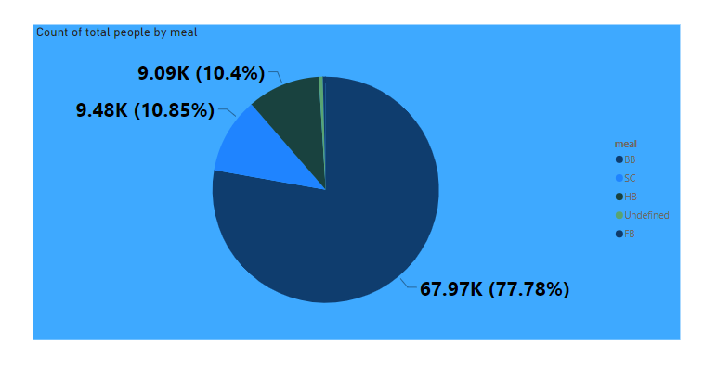
I used the pai chart To check and understand the hotel type is resort or city in simple way of visualizing.
Based on the above observations, I found that Most of Guests like a “77.78 %” Are Preferred A BB Meal. And “10.4%” Guest Preferred A FB meal in hotels.
Are there any insights that lead to negative growth? Justify with specific reason . City hotel can find more services to attract more guests to increase more revenue . Resort Hotel can find a solution to attract customers and also find the facilities provided by the city Hotel to attract customers . So Yes, gained insights help creating a positive business impact.

Slide 20
What did you know about your dataset?
1.The given dataset is of Hotel Booking and we have to analyze and explore this dataset to discover important factors which affects the Hotel Booking. This dataset has 119390 rows and 32 columns.
2. The duplicate value count is 31994 rows.
3. There are 4 columns in dataset which is having missing values and those columns are company, agent, country and children.
4. There are separate columns called adults, children and babies that show the total number of people who are coming to visit, so instead of different columns will add these three in one called total_num_people

